Slide 1
Team - Great Defenders Gulshan Arora Rishabh Pandey Sushikant Singh Asmita Mehrotra “A team is a group of people who trust each other.”
Automated
Patient Care
Manager
August 3rd , 2022 (Hackathon 2022)

Slide 2

Problem Statement
Chronic illnesses and Covid mutations have typically resulted in increased health care expenses and decreased effectiveness in patient care. A solution should be devised to make the Patient care effective so that they can leave the hospital. But this new post pandemic era has further heightened the need of a system which should keep patient care in its center.
The ageing of the baby boomer generation and an increase in chronic diseases across the world are the main causes of the rise in demand of such a system.

Slide 3
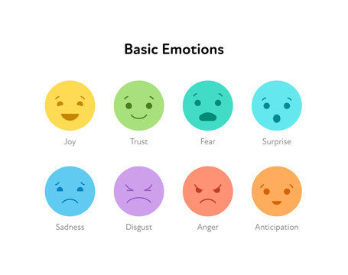
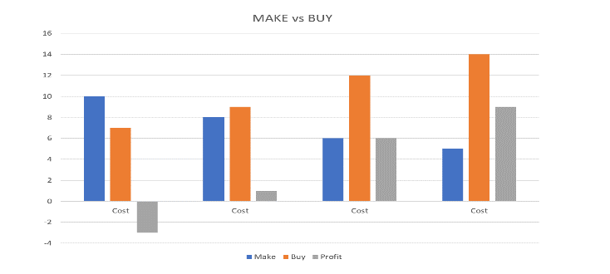
Proposed Solution by Automated Patient Care Manager
Patient Care and Management (PCM) can monitor patients or old age person in case of sudden changes on the basis of certain parameters like facial emotion, glucose level, blood pressure.
A patient in case of emergency can also make use of placards and sign boards. All these parameters trigger an event which can be handled by the healthcare professionals. The idea here is to decrease the in premise hospital staff yet enhance the level of patient care and attention and empathy to each of the patient by making the use of remote patient monitoring devices.

Slide 4
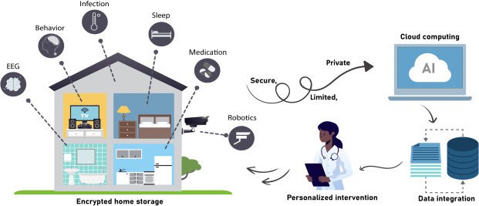






Automated Patient Care Manager
A Next gen, Flexible, Scalable and robust Enterprise grade end to end Remote Patient Care Healthcare Engine.
IOT Service
Real time data movement from device to server.
Security & Scalability
Robust Tenser flow algorithm
User-Validation at each data management layer
Live Data Processing :
Face emotion analysis using Tenser flow
Data Comparison
Automated Auditing
Emotion Monitoring(Mobile and Webapp)
Emotion live analysis
Finding all the emotion ,and other details like age ,wearables for a patient
Proper dashboard to monito patient health
Historical health Data for analysis.
Alert System for Emotions.
Quality Management
Agent Performance Analysis
Script Adherence
Supervisor Performance Analysis
Responsive Design
Top-Down Drilling
On-the-go filtering anywhere-everywhere
Root-Cause Analysis

Slide 5
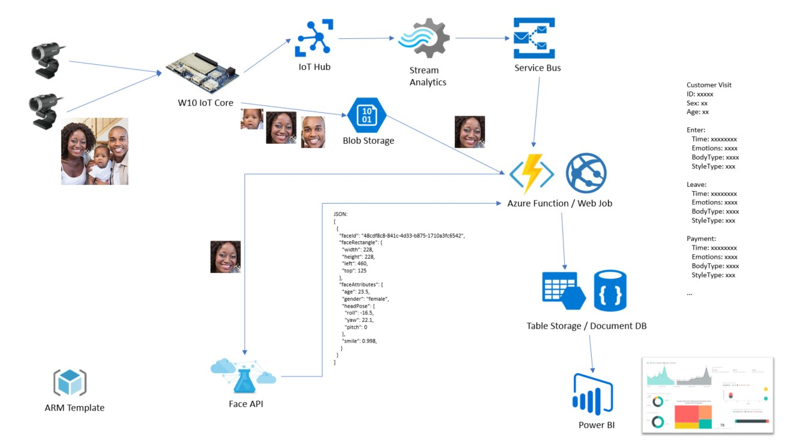
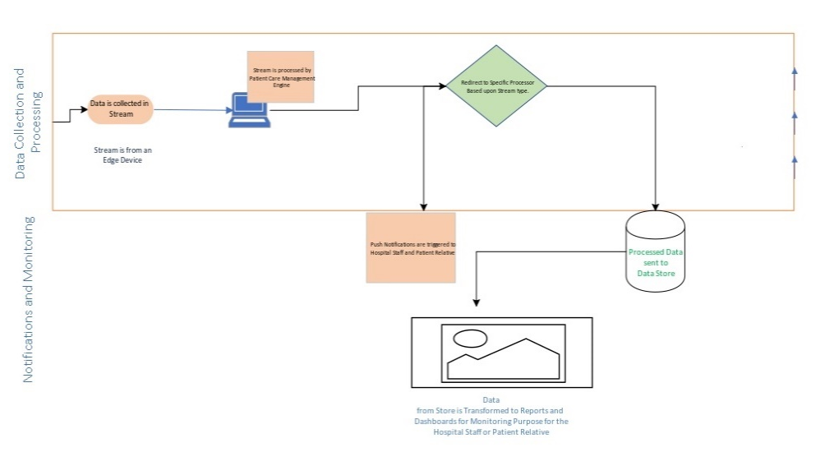
Automated Patient Care Manager Architecture
Current Architecture
Future Architecture

Slide 6
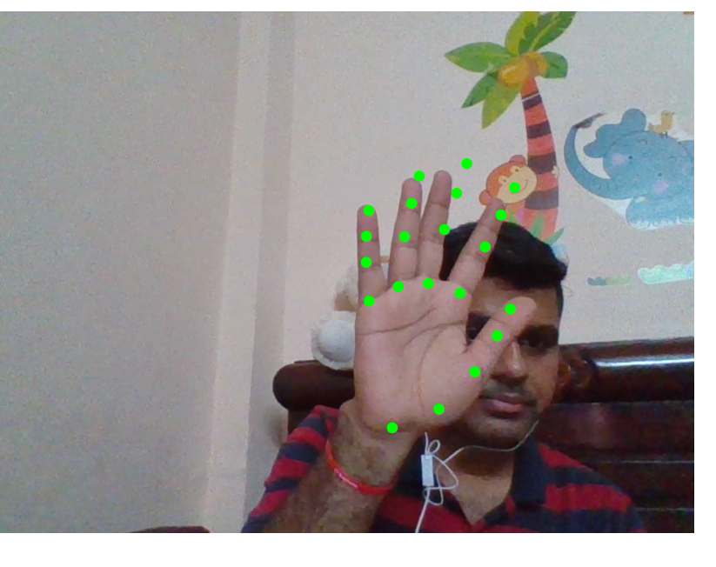
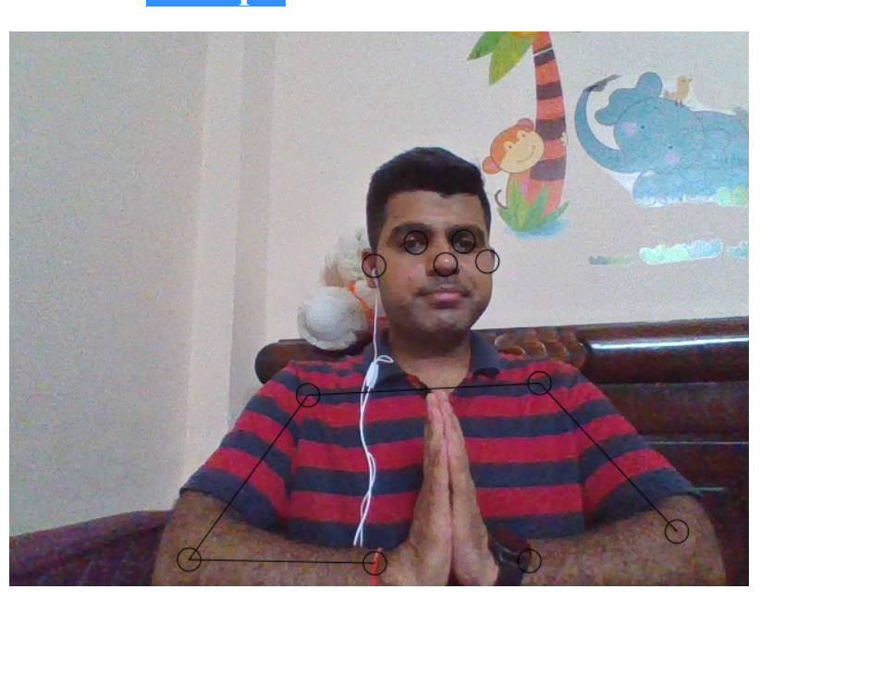
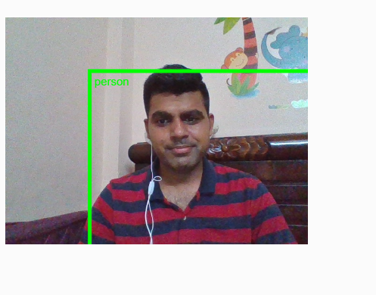
Module-1 IOT Device (Simulator) Part-1 (Movement Detection)
Object Detection
Hand Movement Capture through IOT (Webcam)
Posture Detection

Slide 7
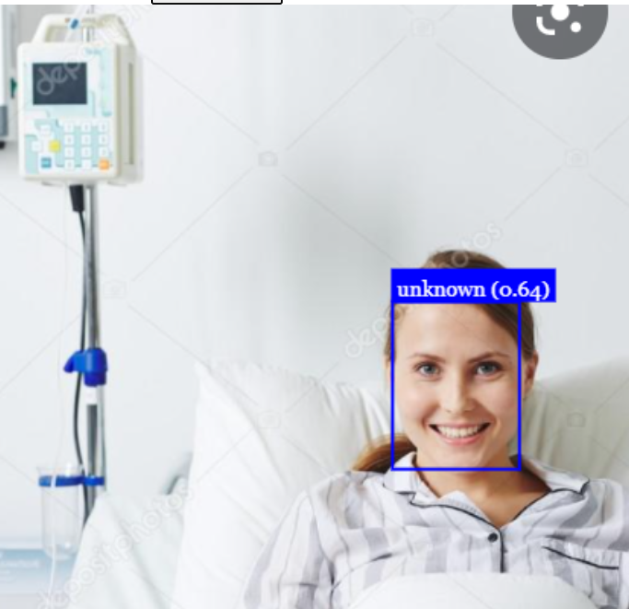
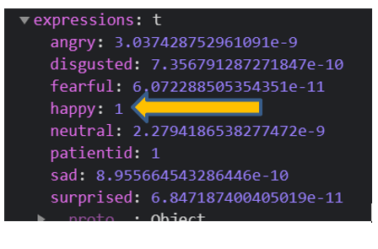
Module-1 IOT Device (Simulator) Part-2 (Emotion Detection)

Slide 8
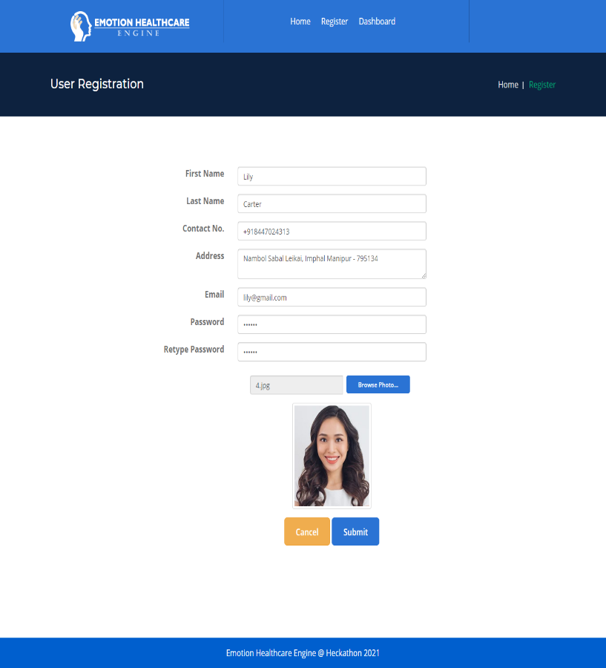
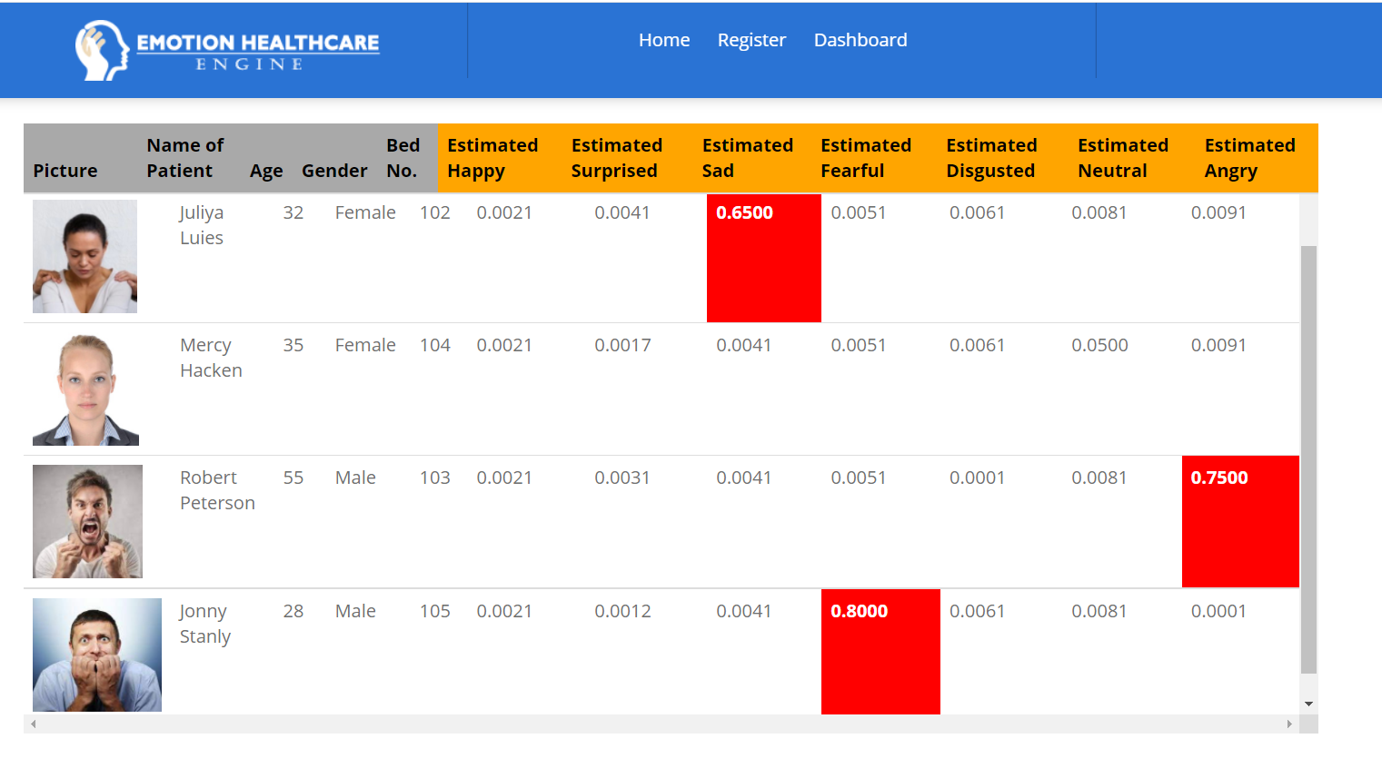
Module-2 WebApp (Mobile App)

Slide 9

Future Scope of proposed Solution
1) Adding Video Emotion Analysis so we can use Telehealth effectively.
2) Integration of our IOT device with other wearable devices “to prompt and track diet, exercise and medication adherence". This integration can help to solve larger health problems.
3) Adding Thermal cameras for live temperature feeding .This can be helpful to detect fever into contagious disease like Covid19.
4) Feedback module will be added into future.
6) IOS application will be added into future.

Slide 10


